Slide 1








1st January 2024 – 31st December 2024
Royal Jersey Laundry
Topline 2024 Carbon Footprint Report

Slide 2

CONTENTS
1. Introduction
4. Appendix
2. 2024 Results Overview
3. Science-Based Targets

Slide 3
Section 1:
Introduction

Slide 4
A Carbon Footprint: The Basics
A carbon footprint is the total quantity of greenhouse gases produced by an organisation, project or place over a given time.
In accordance with the GHG Protocol, the most widely recognised and used standard in carbon accounting, the footprint will be presented as below:
Unit of Measurement
Emission Categories
Dual Reporting
The carbon footprint is expressed in tCO₂e, or tonnes of carbon dioxide equivalents – a standard unit for measuring carbon footprints.
CO₂e expresses the carbon footprint as a single number, based on the global warming potentials of each of the seven Kyoto Protocol greenhouse gases.
The carbon footprint is categorised into 3 ‘Scopes’:
Scope 1: Direct emissions from owned or controlled sources (e.g., building gas usage).
Scope 2: Indirect emissions from generation of purchased electricity, heat or steam.
Scope 3: All indirect emissions that occur in the company value chain
The emissions associated with electricity consumption have been calculated and reported in two ways:
Location-Based: uses the average fuel mix of the region e.g., the UK National Grid
Market-Based: uses the actual fuel mix of the specific tariff purchased e.g., 100% renewable tariff from an energy supplier

Slide 5
Section 2:
2024 Results Overview

Slide 6
2024 Carbon Footprint
Market-Based, Split by Activity and Scope
Activity | GHG Emissions (tCO₂e) |  |  |  | % of Total Footprint
 | Scope 1 | Scope 2 | Scope 3 | Total
Gas | 3,445.78 | - | 569.15 | 4,014.93 | 46.5%
Purchased Goods & Services | - | - | 2,904.81 | 2,904.81 | 33.7%
Transport Fuels | 762.12 | - | 179.87 | 941.98 | 10.9%
Electricity | - | 556.06 | 165.19 | 721.25 | 8.4%
Employee Commuting | - | - | 28.85 | 28.85 | 0.3%
Water | - | - | 16.91 | 16.91 | 0.2%
Waste | - | - | 1.90 | 1.90 | 0.02%
Business Travel | - | - | 1.54 | 1.54 | 0.02%
Total (Market-Based) | 4,207.90 | 556.06 | 3,868.20 | 8,632.16 | 100%
Market-based methodology calculates electricity emissions using supplier-specific fuel mix.
Market-based totals will be used for the remainder of this report, unless stated otherwise.
Table 1. Market-based GHG emissions in 2024, split by Scope and Category.

Slide 7
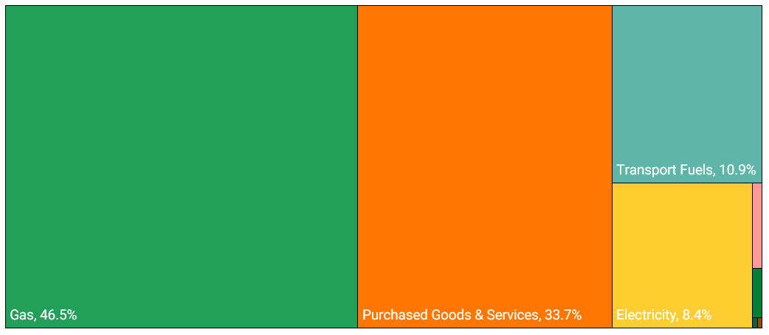
2024 Carbon Footprint
Market-Based, Split by Activity and Scope
Employee Commuting, 0.3%
Water, 0.2%
Waste, 0.02%
Figure 1. Market-based GHG emissions in 2024, split by category and presented as a tree-map.
Business Travel, 0.02%

Slide 8
2024 Carbon Footprint
Market-Based, Split by Scope
Activity | GHG Emissions (tCO₂e) | % of Total
Scope 1 | 4,207.90 | 48.7%
Scope 2 | 556.06 | 6.4%
Scope 3 | 3,868.20 | 44.8%
Total (Market-Based) | 8,632.16 | 100%
Market-based methodology calculates electricity emissions using supplier-specific fuel mix.
Table 2. Market-based GHG emissions in 2024, split by scope.

Slide 9
Section 3:
Near-Term and Net-Zero Science-Based Targets

Slide 10
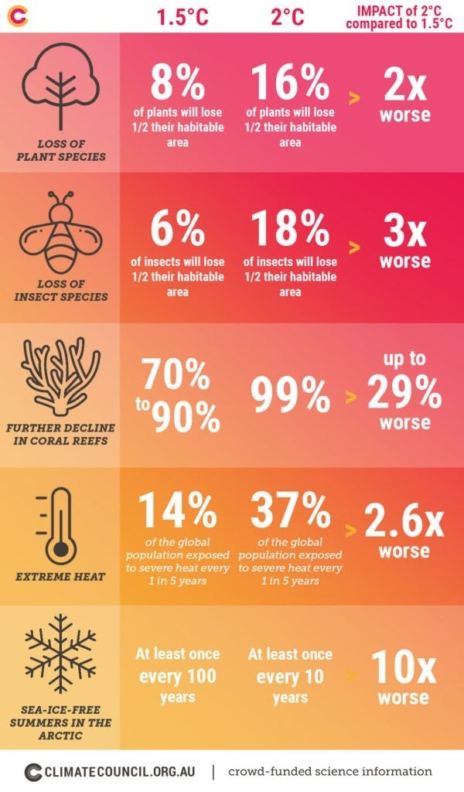
Target Setting
Why is it Fundamental?
Climate science predicts that unless we dramatically curb temperature rise, we will see catastrophic impacts of climate change.
The Paris Agreement in 2015 saw 200 countries pledge to keep global temperatures preferably below 1.5C. The 1.5C was defined as the cap that, if exceeded, will see such catastrophic climate impacts.​
Whilst nation states have pledged to this agreement, it’s fundamental that organisations can make the same commitment.

Slide 11
Target Setting
What are SBTs?
Created by the Science Based Target Initiative (SBTi), SBTs provide companies with a clearly-defined pathway to set targets and reduce emissions in line with the global target of limiting global warming below 1.5C.
This makes them more robust and meaningful and in line with climate science. SBTs also set you on a pathway to reach real science-based net-zero by 2050 at the latest.
Why is Science Based Target Setting Fundamental?
Climate science predicts that, unless we dramatically curb temperature rise, we will see catastrophic impacts of climate change.
The Paris Agreement in 2015 saw 200 countries pledge to keep global temperatures preferably below 1.5C. The 1.5C was defined as the cap that, if exceeded, will see such catastrophic climate impacts.​
Whilst nation states have pledged to this agreement, it’s fundamental that organisations can make the same commitment.
Science-Based Targets

Slide 12
Science-Based Net-Zero Criteria
The SBTi defines science-based net-zero as the achievement of three key steps:
1. Near-Term SBTs
42% Reduction
2. Long-Term SBTs
90% Reduction
1. Near-Term SBTs
What companies will do now, and over the next 5-10 years, to reduce emissions. This requires a 42% reduction by 2030 to be in line with 1.5C limit on global heating.
2. Long-Term SBTs
The degree of decarbonisation companies need to ultimately reach net-zero. This requires a 90% reduction by a chosen net-zero year, which must be 2050 or earlier.
3. Neutralisation of Residual Emissions
The residual GHGs left once long-term SBT has been achieved must be counterbalanced through the permanent removal and storage of carbon from the atmosphere. Removals of residuals is required in order to claim net-zero status.
GHG Emissions (tCO₂e)
10% Residual
Removals
Baseline
2030
2050
3. Neutralisation of 10% Residuals
Figure 2. SBTi’s net-zero requirements timeline. Based on: SBTi Corporate Net-Zero Standard (Net-Zero-Standard.pdf (sciencebasedtargets.org)

Slide 13
Science-Based Targets for Royal Jersey Laundry
 | Near-Term | Long-Term Net-Zero
Target Year | 5-10 years from date of target submission | 2050 (or sooner)
Scopes 1 and 2 | Coverage: 95% of total emissions Reduction Required: 42% absolute reduction by 2030 | Coverage: 95% of total emissions Reduction Required: 90% absolute reduction
Scope 3 | Coverage: 67% of total emissions* Reduction Required: Absolute Reduction Method: Minimum 42% absolute reduction by 2030 OR Intensity Reduction Method (Physical or Economic): 51.6% reduction by 2030 | Coverage: 90% coverage of total emissions Reduction Required: Absolute Reduction Method: 90% absolute reduction AND neutralisation of final 10% of emissions by permanent, physical carbon removals OR Intensity Reduction Method (Physical or Economic): 97% physical intensity reduction AND neutralisation of remaining residual emissions by permanent, physical carbon removals
Table 3. Overview of what science-based targets look like for Royal Jersey Laundry.
* Currently, the SBTi does not have an official system for validating Scope 3 near-term targets for SMEs. Instead, an SME must commit to measure and reduce their Scope 3 emissions.

Slide 14
Near-Term Targets
Scope 1, Absolute Contraction Approach
TARGETS CONTENT: | Near-Term |  |  | Long-Term
 | Scope 1 | Scope 2 | Scope 3 | Scope 1 | Scope 2 | Scope 3
Approach: Absolute Reduction
Target Year: 2030
Reduction Ambition: 42% (Minimum Requirement)
For its scope 1 near-term target, Royal Jersey Laundry’s target is a 42% reduction in absolute scope 1 emissions by 2030.
In 2024, scope 1 emissions made up 48.7% of Royal Jersey Laundry’s carbon footprint. These largely came from natural gas used on site (81.9%) as well as fuels used in company-owned and leased vehicles (18.1%).
It should be noted that in 2024, there were no fugitive losses (or refrigerant leaks). However, as these leaks are variable year-to-year, Royal Jersey Laundry should continue to track any refrigerant top ups and conduct regular maintenance on any A/C units to minimise leakage.
Figure 3. Scope 1 near-term Science Based Target.

Slide 15
Near-Term Targets
Scope 2, Absolute Contraction Approach
TARGETS CONTENT: | Near-Term |  |  | Long-Term
 | Scope 1 | Scope 2 | Scope 3 | Scope 1 | Scope 2 | Scope 3
Approach: Absolute Reduction
Target Year: 2030
Reduction Ambition: 42% (Minimum Requirement)
For its scope 2 near-term target, Royal Jersey Laundry’s target is a 42% reduction in absolute scope 2 emissions by 2030.
In 2024, scope 2 emissions made up 6.4% of Royal Jersey Laundry’s carbon footprint. These scope 2 emissions came entirely from electricity used on site.
Figure 4. Scope 2 near-term Science Based Target.

Slide 16
Near-Term Targets
Scope 3, Absolute Contraction Approach
TARGETS CONTENT: | Near-Term |  |  | Long-Term
 | Scope 1 | Scope 2 | Scope 3 | Scope 1 | Scope 2 | Scope 3
Mapped Approach: Absolute Reduction
Mapped Target Year: 2030
Reduction Ambition: 25% (Minimum Requirement) OR 42%
For its scope 3 near-term target, Royal Jersey Laundry has a few methods it can choose from. The first would be a reduction based on its absolute scope 3 emissions, as mapped in Figure 5. Within this absolute contraction approach, Royal Jersey Laundry could either follow a 25% reduction trajectory, or a more ambitious 42% reduction by 2030.
The alternative scope 3 target method could be a reduction of normalised scope 3 emission based on either physical or economic intensity. Within this intensity approach, Royal Jersey Laundry would need to reduce its normalised GHG emissions by 51.6% by 2030 (not currently modelled).
In 2024, 44.8% of Royal Jersey Laundry’s GHG emissions fell under scope 3 emissions.
Figure 5. Scope 3 near-term Science Based Target.

Slide 17
Long-Term Net-Zero Target
All 3 Scopes, Absolute Contraction Approach
TARGETS CONTENT: | Near-Term |  |  | Long-Term
 | Scope 1 | Scope 2 | Scope 3 | Scope 1 | Scope 2 | Scope 3
Figure 6.
Net-zero target, all scopes, under three target year scenarios.
Royal Jersey Laundry’s long-term net-zero reduction trajectory has been mapped above in Figure 6. Unlike the near-term targets previously discussed, the long-term net-zero target is a 90% reduction of scopes 1, 2, and 3 by 2050 or sooner. 2040, 2045, and 2050 pathways have been mapped as potential target dates.
The remaining 10% GHG emissions are referred to as “residual emissions,” which are to be permanently removed using nature- or technology-based solutions.

Slide 18
Possible Messaging for RJ Laundry’s Website
“In 2024, we emitted 8,632.16 tCO₂e, from the following sources:
[Include summary table split by scope in slide 8]
Royal Jersey Laundry has set near-term and net-zero science-based targets aligned with the Science Based Targets initiative (SBTi).
Our scope 1 near-term target is a 42% reduction in scope 1 emissions by 2030 from a 2024 baseline year.
Our scope 2 near-term target is a 42% reduction in scope 2 emissions by 2030 from a 2024 baseline year.
Our scope 3 near-term target is a [25% OR 42%] reduction in scope 3 emissions by 2030 from a 2024 baseline year.
Our net-zero target is a 90% reduction in combined scope 1, 2, and 3 emissions by [2040, 2045 OR 2050] from a 2024 baseline year.”

Slide 19
Thank you!
Any questions?

Slide 20
Section 4:
Appendix

Slide 21
2024 Carbon Footprint
Location-Based, Split by Activity and Scope
Activity | GHG Emissions (tCO₂e) |  |  |  | % of Total Footprint
 | Scope 1 | Scope 2 | Scope 3 | Total
Gas | 3,445.78 | - | 569.15 | 4,014.93 | 47.6%
Purchased Goods & Services | - | - | 2,904.81 | 2,904.81 | 34.5%
Transport Fuels | 762.12 | - | 179.87 | 941.98 | 11.2%
Electricity | - | 388.81 | 128.01 | 516.83 | 6.1%
Employee Commuting | - | - | 28.85 | 28.85 | 0.3%
Water | - | - | 16.91 | 16.91 | 0.2%
Waste | - | - | 1.90 | 1.90 | 0.02%
Business Travel | - | - | 1.54 | 1.54 | 0.02%
Total (Location-Based) | 4,207.90 | 388.81 | 3,831.03 | 8,427.74 | 100%
Location-based methodology calculates electricity emissions using the average fuel mix of the region (i.e. the UK National Grid).
Table A1. Location-based GHG emissions in 2024, split by Scope and Category.

Slide 22
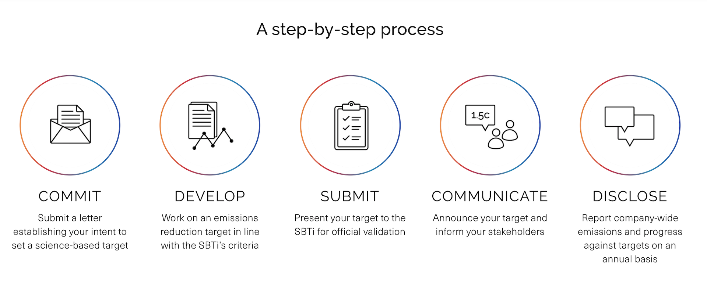
Science-Based Targets Validation Process
Below is the step-by-step process of having targets officially validated by the SBTi.
Source: Guidance from the SBTi website.
Not applicable for SMEs

Slide 23
Methodology: General
Carbon Factors
Carbon factors sourced from a range of governmental and environmental organisational databases (e.g., UK government, EPA, National Grid etc.) and consumption data (e.g., kWh of electricity) were used to calculate RJ Laundry’s carbon footprint.

Slide 24
Methodology: Carbon Factors
Core carbon factors have been sourced from the below inventories:
Carbon Factor | Source
IPCC Emissions Factor Database​ | https://www.ipcc-nggip.iges.or.jp/EFDB/main.php​
Global Emissions Model for Integrated Systems​ | http://iinas.org/gemis.html​
UK Government Factors​ | https://www.gov.uk/government/collections/government-conversion-factors-for-company-reporting​
EPA US Factors​ | https://www.epa.gov/sites/production/files/2018-03/documents/emission-factors_mar_2018_0.pdf​ https://www.gov.uk/government/collections/government-conversion-factors-for-company-reporting​
World Input Output Database – financial spend​ | http://www.wiod.org/home​
GHG Scope 3 Evaluator​ | https://ghgprotocol.org/scope-3-evaluator​

Slide 25

Further Reading & Resources
GHG Protocol Corporate Reporting Standard: Corporate Standard | Greenhouse Gas Protocol (ghgprotocol.org)​
GHG Protocol Scope 3 Calculation Guidance: Scope 3 Calculation Guidance | Greenhouse Gas Protocol (ghgprotocol.org)​
Science Based Targets Initiative (SBTi) setting and validation process: Set a Target - Science Based Targets​
SBTi new (launched 28/10/2021) net-zero standard: The Net-Zero Standard - Science Based Targets​
Green Element Podcast: Sustainable Business Podcast - Green Element​
Green Element Guides: Environmental and Sustainability ebooks | Green Element

